Slide 1
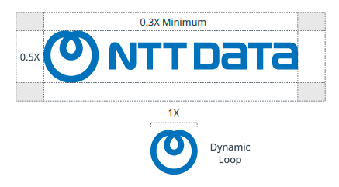




Please read and delete before presenting
Template usage
General template usage rules:
Title slide photos may be changed.
Do not edit or modify master slide elements (ex., do not change the color or
placement of title page elements).
Do not infringe on or cover up the branded elements (respect the logo isolation, copyright, etc.).
Do not mix template “styles” within the same slide deck. Stay consistent with background colors. Avoid alternating light and dark background slides in the
same presentation.
Conduct an accessibility scan of your document and address as many identified issues as possible. Microsoft provides resources that can help.
Brand basics:
For page titles use the Georgia font, for general text use Arial.
Follow the logo rules outlined in the NTT DATA Visual Identity System Guidelines (VIS).
Any logo inclusion must follow all associated guidelines for the respective marks.
Logo isolation: Maintain adequate space around the logo.
Color Picker
Color Picker
A
B
A
B
C
D
E
Do not use the Dynamic Loop alone.
C
D
E
F
G
H
F
G
H
I
J
K
I
J
K
L
M
N
Background
colors
Foreground
accent Colors
Attention
grabbing colors
More
accents
Text
colors
L
M
N
O
P
Q
O
P
Q
R
S
O
T
R
S
Orange 150
RGB: 178 / 32 / 0
Hex: B22000
Black*
RGB: 0 / 0 / 0
Hex: 000000
T
A
U
B
Logo colors:
T
A
U
B
A
C
F
I
P
A
Smart Navy
RGB: 7 / 15 / 38
Hex: 070F26
Future Blue 150
RGB: 0 / 91 / 150
Hex: 005B96
Turquoise 100
RGB: 0 / 154 / 164
Hex: 009AA4
Green 150
RGB: 6 / 137 / 65
Hex: 068941
Orange 100
RGB: 228 / 38 / 0
Hex: E42600
Smart Navy
RGB: 7 / 15 / 38
Hex: 070F26
B
D
G
J
L
Q
R
U
White
RGB: 255 / 255 / 255
Hex: FFFFFF
Future Blue
RGB: 0 / 114 / 188
Hex: 0072BC
Turquoise
RGB: 0 / 223 / 237
Hex: 00DFED
Green
RGB: 0 / 203 / 93
Hex: 00CB5D
Yellow
RGB: 255 / 196 / 0
Hex: FFC400
Orange
RGB: 255 / 122 / 0
Hex: FF7A00
Grey 100
RGB: 148 / 148 / 148
Hex: 949494
Text Grey
RGB: 46 / 64 / 77
Hex: 2E404D
Future Blue
White
Black
E
H
K
M
S
B
Future Blue 50
RGB: 25 / 163 / 252
Hex: 19A3FC
Turquoise 50
RGB: 123 / 247 / 255
Hex: 7BF7FF
Green 50
RGB: 56 / 249 / 144
Hex: 38F990
Yellow 100
RGB: 255 / 219 / 102
Hex: FFDB66
Grey 50
RGB: 232 / 232 / 232
Hex: E8E8E8
White
RGB: 255 / 255 / 255
Hex: FFFFFF
Logo legibility: Ensure logo is clearly visible at all times. Avoid using the logo over busy backgrounds.
NTT DATA is always ALL CAPS, and always on one line. Do not wrap the company name in text.
N
Yellow 50
RGB: 255 / 237 / 178
Hex: FFEDB2
* To be used in select use cases, only.

Slide 2
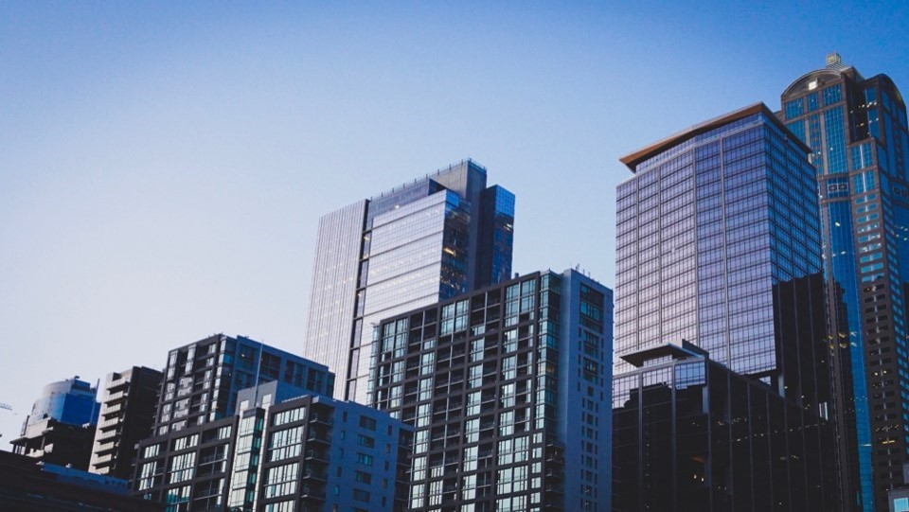
Cover Slide Example 1
Full Image Background, Full
Innovation Curve

Slide 3
Agenda
ID | Section | Page
1 | xxx | X
2 | xxx | X
3 | xxx | X
4 | xxx | X
5 | xxx | X
6 | xxx | X
7 | xxx | X
ID | Section | Page
8 | xxx | X
9 | xxx | X
10 | xxx | X
11 | xxx | X
12 | xxx | X
13 | xxx | X
15 | xxx | X

Slide 4
Text: Level 1
  Text: Level 2
    Text: Level 3
      Text: Level 4
        Text: Level 5

Slide 5
Text: Level 1
  Text: Level 2
    Text: Level 3
      Text: Level 4
        Text: Level 5

Slide 6
Text: Level 1
  Text: Level 2
    Text: Level 3
      Text: Level 4
        Text: Level 5
Text: Level 1
  Text: Level 2
    Text: Level 3
      Text: Level 4
        Text: Level 5

Slide 7
Text: Level 1
  Text: Level 2
    Text: Level 3
      Text: Level 4
        Text: Level 5
Text: Level 1
  Text: Level 2
    Text: Level 3
      Text: Level 4
        Text: Level 5
Text: Level 1
  Text: Level 2
    Text: Level 3
      Text: Level 4
        Text: Level 5

Slide 8
 |  |  | Aggregated Columns
Column 1 | Column 2 | Column 3 | Column 4 | Column 5 | Column 6
TBD | TBD | TBD | TBD | TBD | TBD
TBD | TBD | TBD | TBD | TBD | TBD
TBD | TBD | TBD | TBD | TBD | TBD

